Slide 1
Player’s auction & team making for tournament
Presenting by :
Md Iftekhar Hossain Tushar
B.Sc (engineering) in CSE
Level : 4 Semester : I
Student ID : 1902061
Azizur Rahman Maruf
B.Sc (engineering) in CSE
Level : 4 Semester : I
Student ID : 1902029

Slide 2
contents
Introduction
Objectives
Literature Review
Requirements
Architecture
Implementation
Future Enhancement
Conclusion
References

Slide 3
Introduction
The modern world is characterized by an increasing reliance on automobiles for daily transportation needs. As the number of vehicles on the road continues to rise, the demand for efficient and effective driving education programs becomes imperative. To address this need, the Driving School Management System is proposed as a comprehensive solution to streamline and enhance the operations of driving schools.

Slide 4
Objectives
In here User can fill up the from as he wanted for learning bike,Car or heave vehicle.
In the program section user ca view our programs.
In the about section people can read about the objectives of our site.
In the contact section user can contact if there is any problem or anyone want to know more about us.
In the authority section an authority can control all the major fact.
In the log in section we have kept two option one for user and other for authority.

Slide 5

LITERATURE REVIEW
For Literature Survey, we have visited website related to our system. We have also visited some website for learning methods related to html ,css,javascript,php and MySQL language for DBMS.

Slide 6
requirements
Software Requirements
Operating System Windows 10
Front End Java, Java Swing, Java AWT
Back End MySQL
IDE NetBeans, Workbench
Hardware Requirements
Desktop PC or a Laptop
Operating System – Windows 10
Intel® CoreTM i3-6006U CPU @ 2.00GHz
4.00 GB RAM
64-bit operating system, x64 based processor
1024 x 768 monitor resolution
Keyboard and Mouse

Slide 7
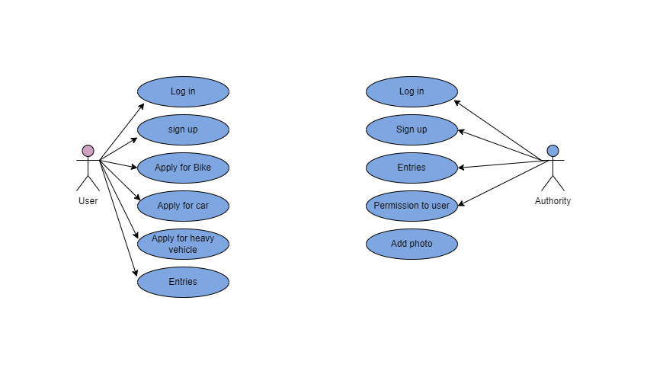
Architecture
Use-case diagram

Slide 8
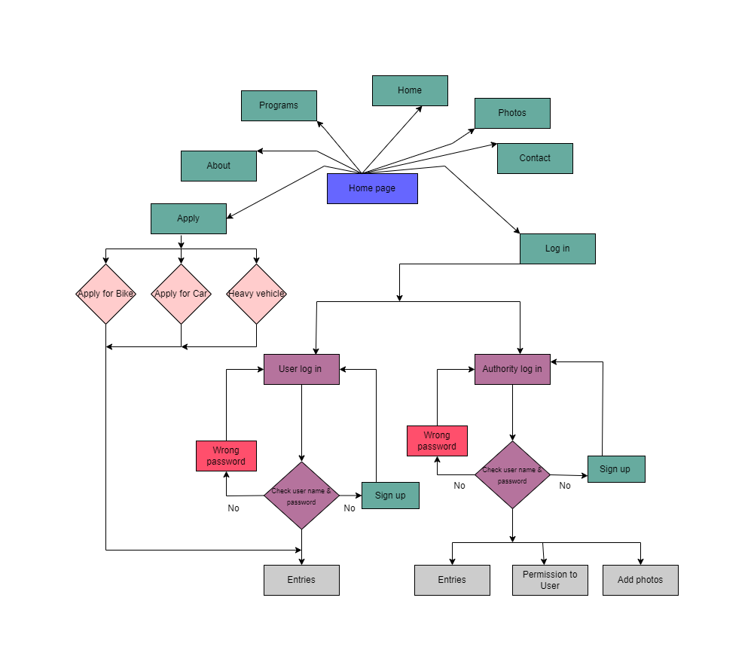
Architecture
E-R diagram

Slide 9
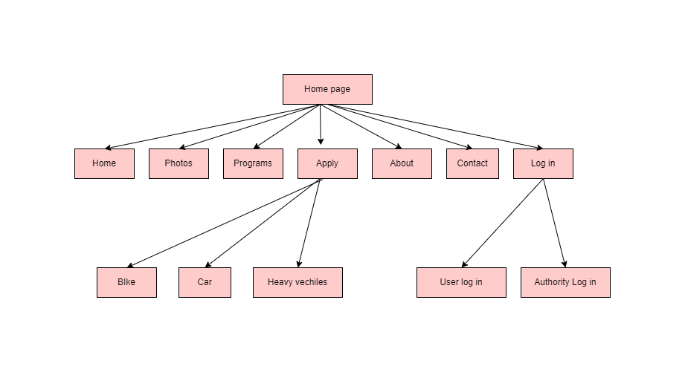
Architecture
Process diagram

Slide 10
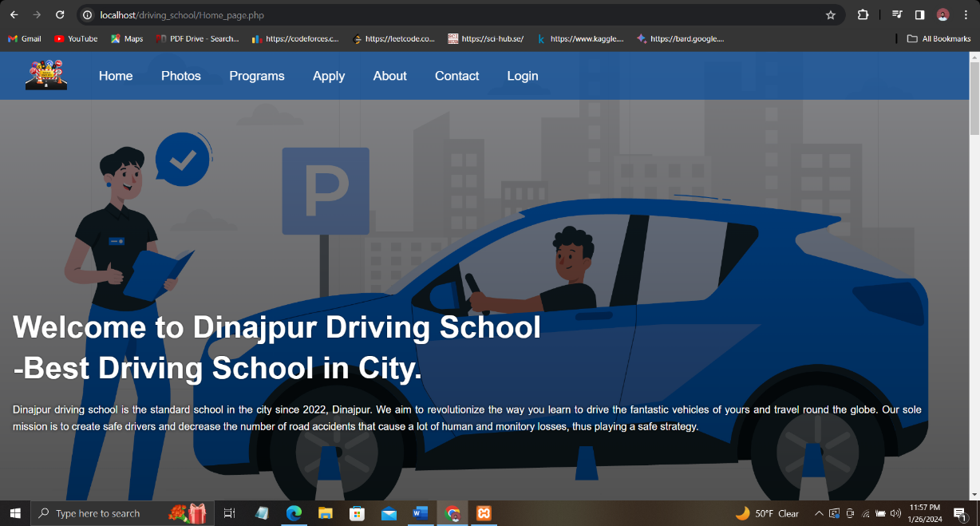
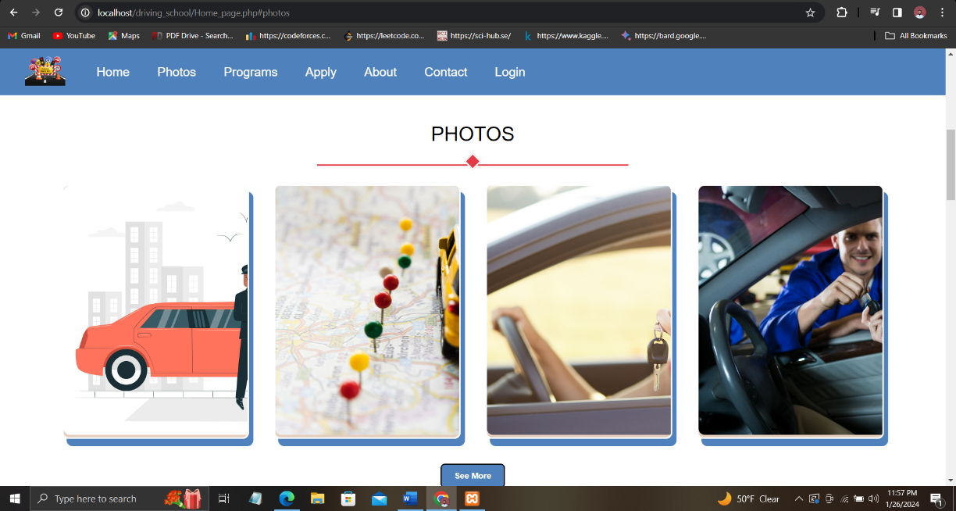
Implementation
Opening page of “Dinajpur Driving School”. It is the home section.
Next it is the photos section here we can see the photos of our programs.

Slide 11
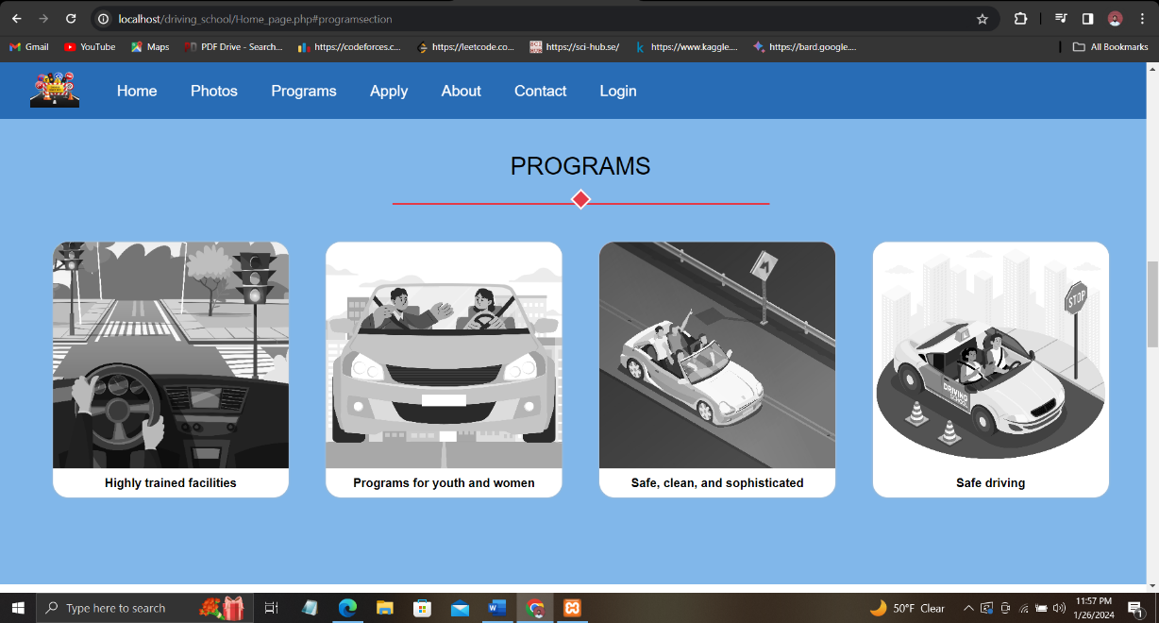
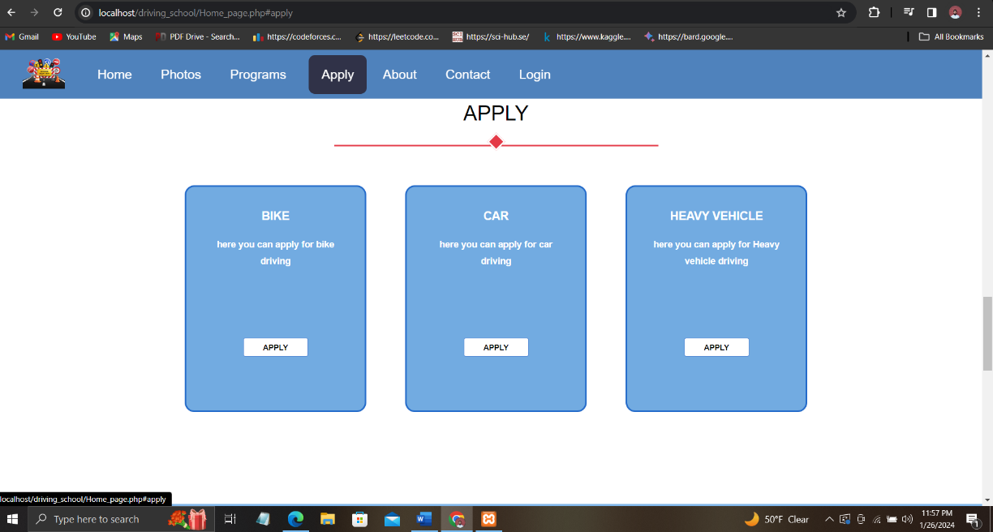
Implementation
It is the programs section in here we will see the programs for our driving school.
And in the left section we have apply here user can apply for there need like bike ,car ,etc

Slide 12
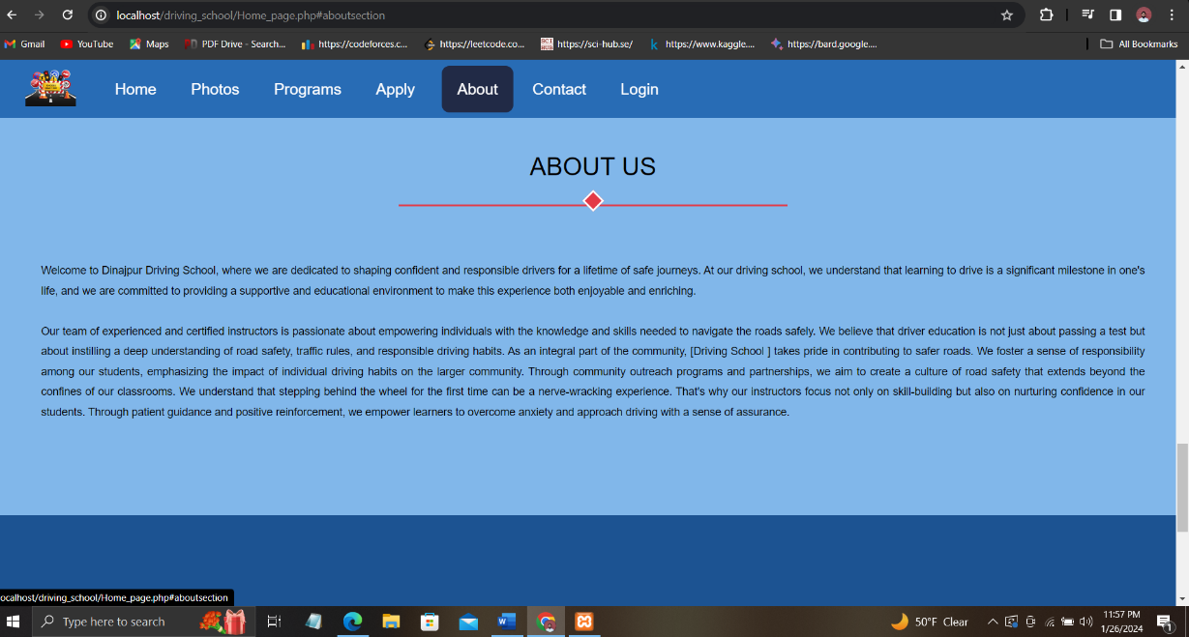
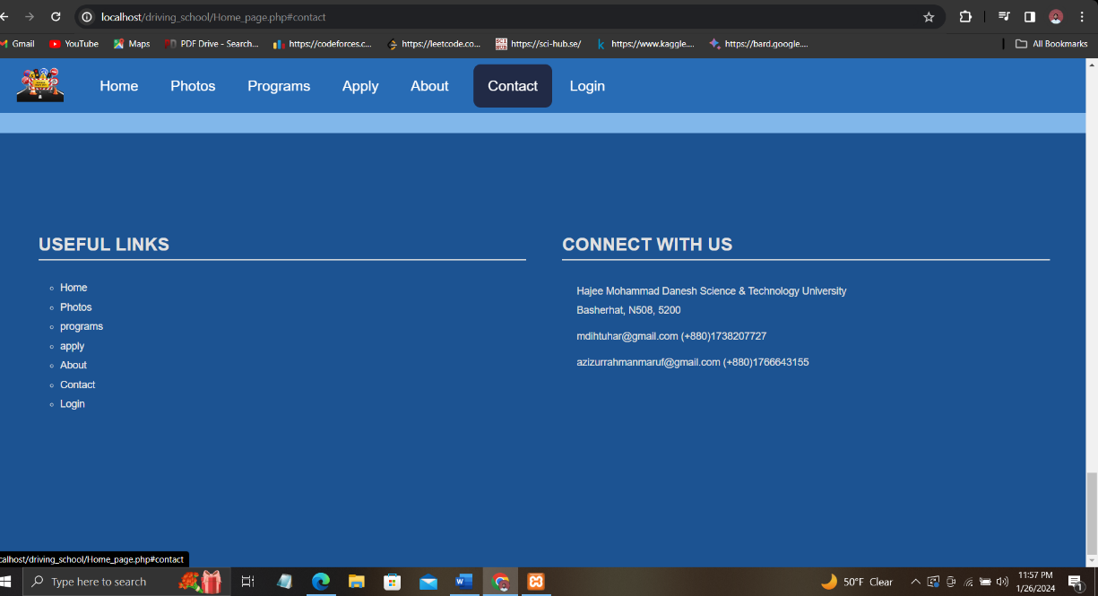
Implementation
Authority can add team & player information by the interface presented in left.
Added teams’ information with editing opportunities presented in right.

Slide 13
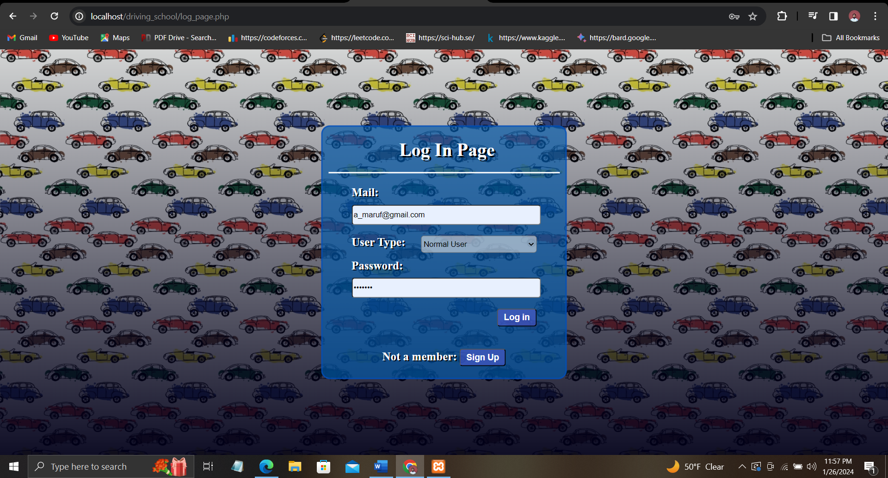
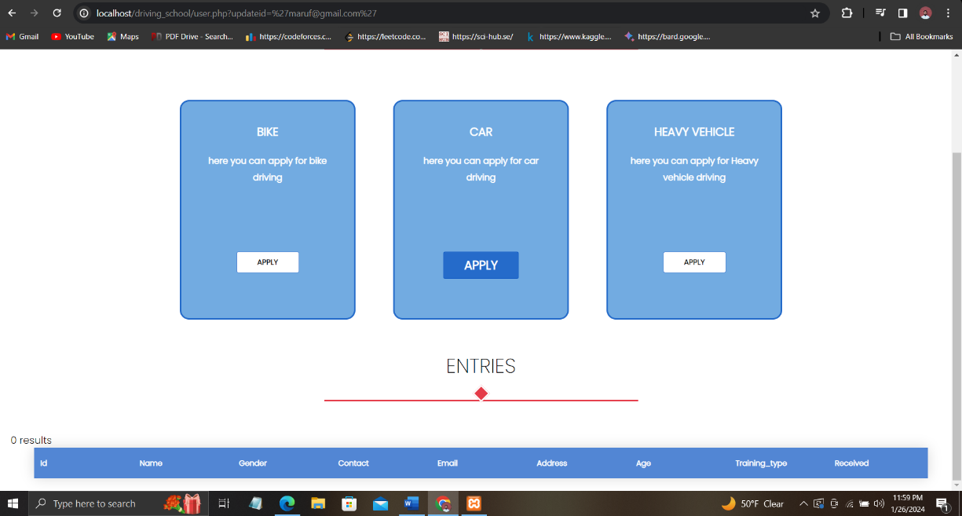
Implementation
Here we have log in page there are two option one id for user and another is for authority.
In the left side we see that user can log in

Slide 14
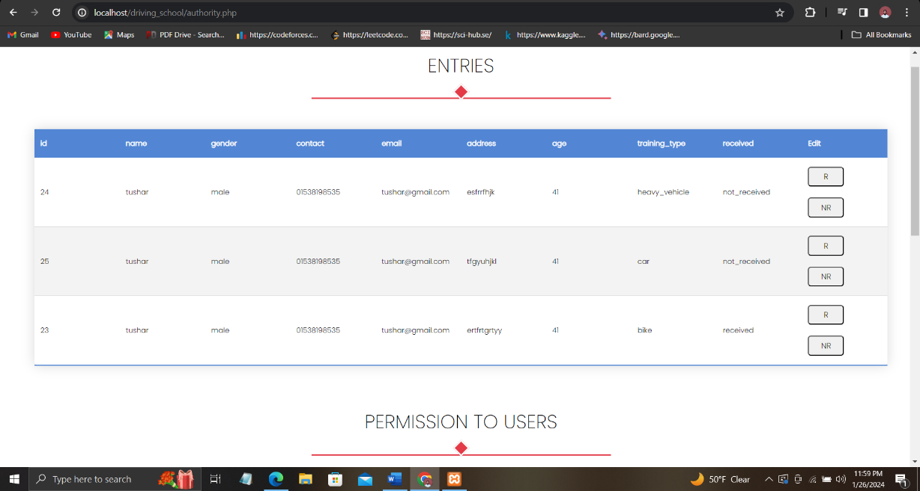
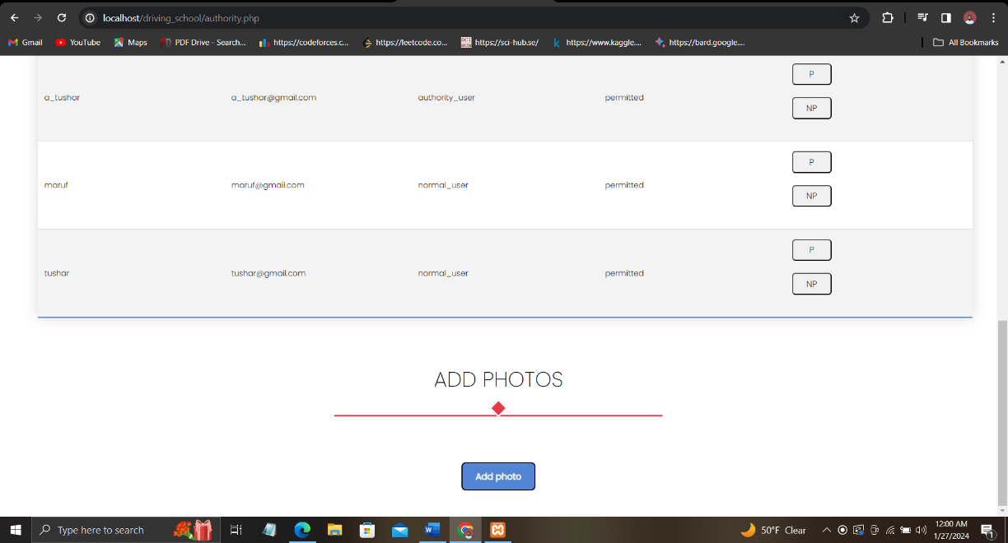
Implementation
Here the authority can view the entries and permission for user and see the photos.

Slide 15
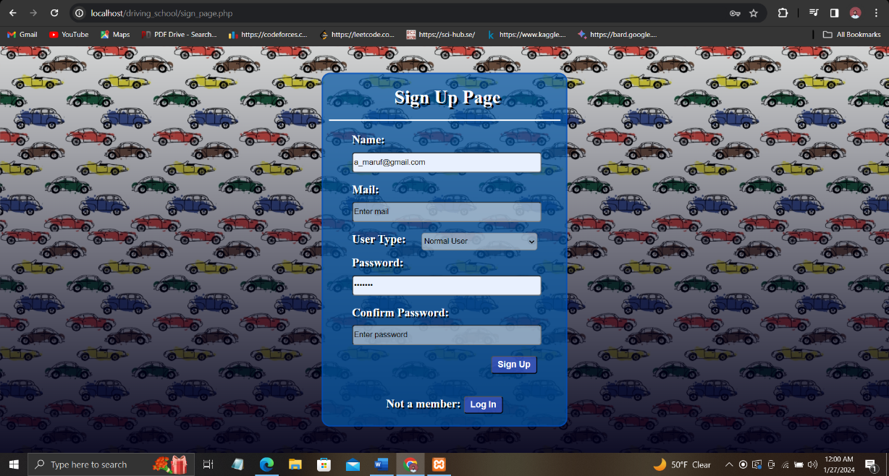
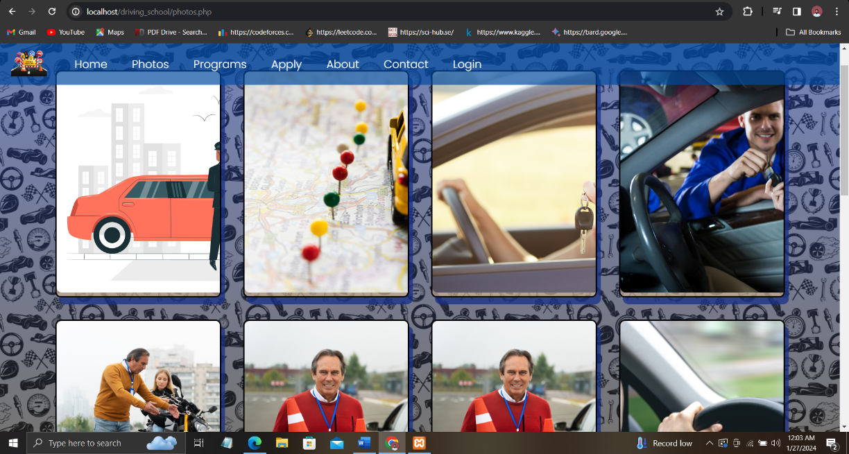
Implementation
Here we will see a page that who are not sign up they can sign up for there need

Slide 16
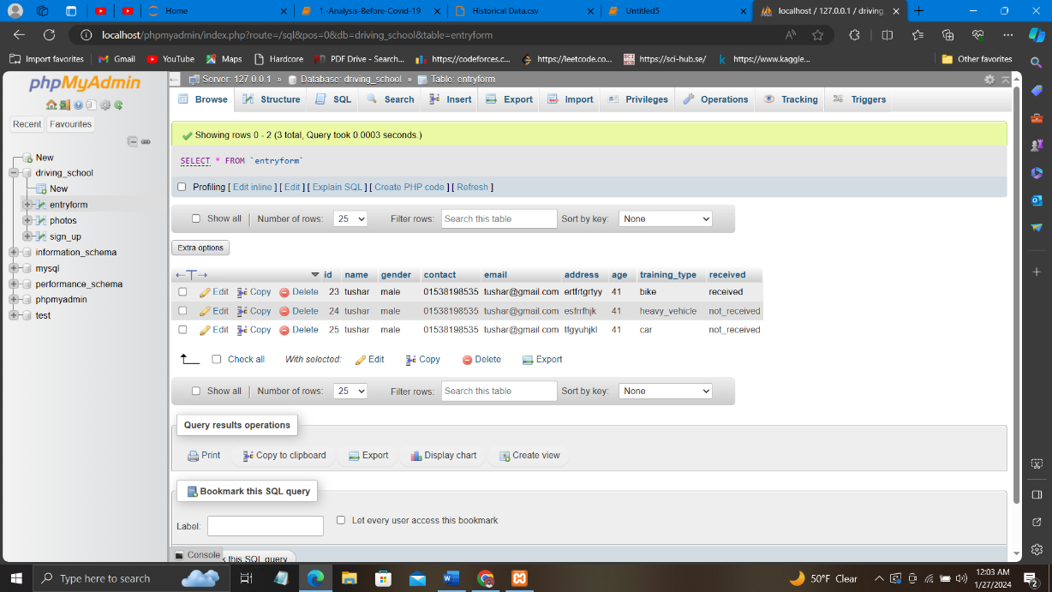
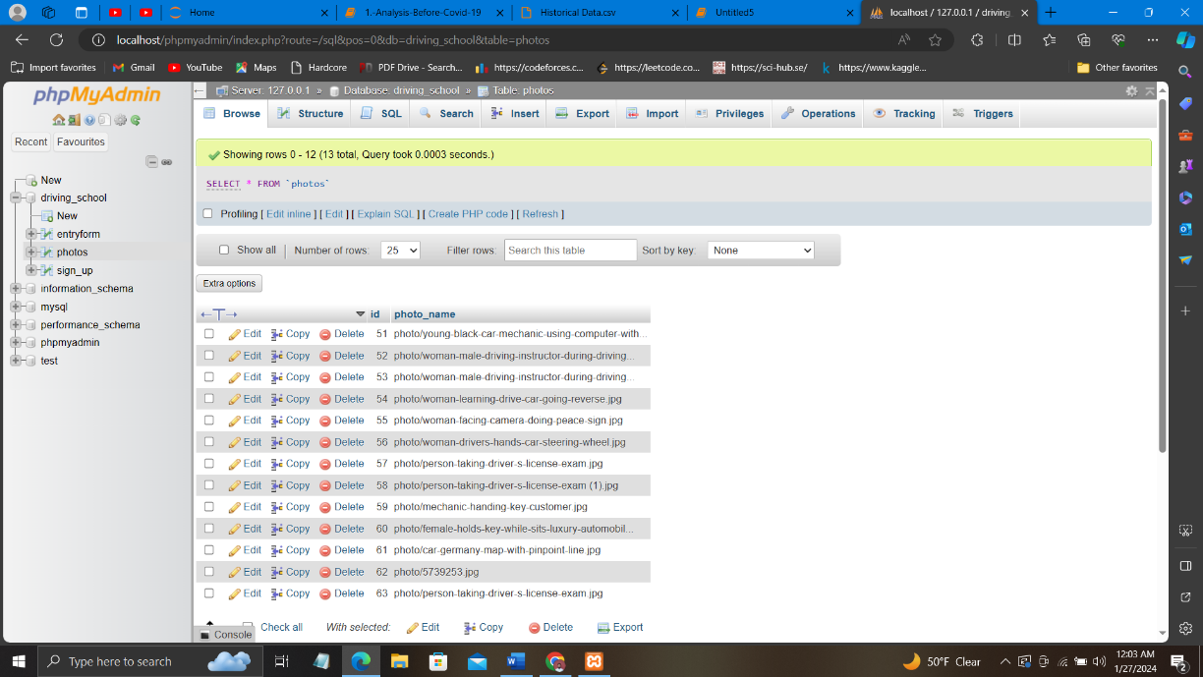
Implementation
Here we can see the database section and one is for entry form and another is for phots section

Slide 17
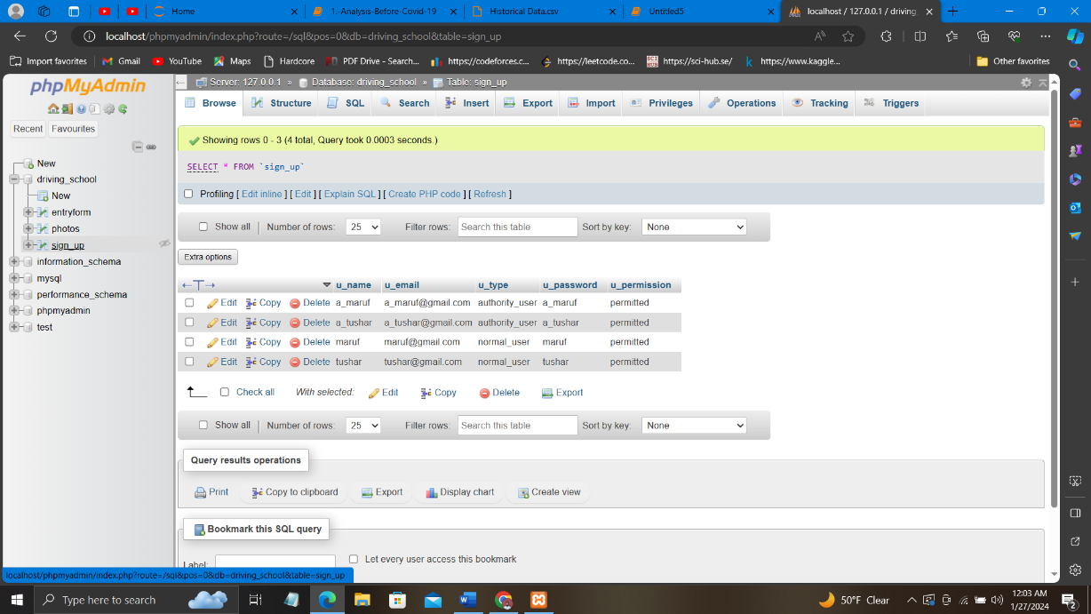
Implementation
It is the database for sign up section

Slide 18
Future enhancement
1. We will do more details work in Home page, photos page , About page and Contact page .
2. We will add more security feature .
3. we will add Virtual Reality (VR) Simulations.
4. we will add an extra page for adding safety rules.

Slide 19
Conclusion
In our proposed system we have build a system where we can help every local people in Dinajpur. Here we have kept option for user and authority and user can log in and
Fil the form for learning driving bike,car etc.On the otherhand authority can edit the function and maintenance the security.

Slide 20
reference
https://www.shimudrivingschool.com/
https://driving-school.com/
https://themeforest.net/search/driving%20school
https://dribbble.com/tags/driving-school-website
https://dribbble.com/tags/driving-school-website

Slide 21
Thank you

